Slide 1
Cloud Hardware and Software
Session 04
Course : COSC6100001 - Cloud Infrastructure
D6825 - Samuel Philip

Slide 2
Learning Objectives
(C4) Analysis : identify problems that can be solved using cloud global infrastructure
(C2) Comprehension : group Classify real-worlds problems in accordance with cloud computing infrastructure

Slide 3
Outline
Cloud Infrastructure Challenges
Cloud Hardware; Warehouse-scale Computer (WSC)
Cluster Management System
Containers
Kubernets

Slide 4
Cloud Infrastructure Challenges

Slide 5

Cloud Infrastructure Challenges
Integrate a very large number of system components and contributes to the challenge of ensuring efficient and reliable operation.
The scale of the cloud infrastructure, combined with the relatively low mean-time to failure of the off-the-shelf components.
Availability. For example, a 99% availability translates to 22 hours of downtime per quarter.
Only a fair level of hardware redundancy combined with software support for error detection and recovery can ensure such a level of availability.

Slide 6
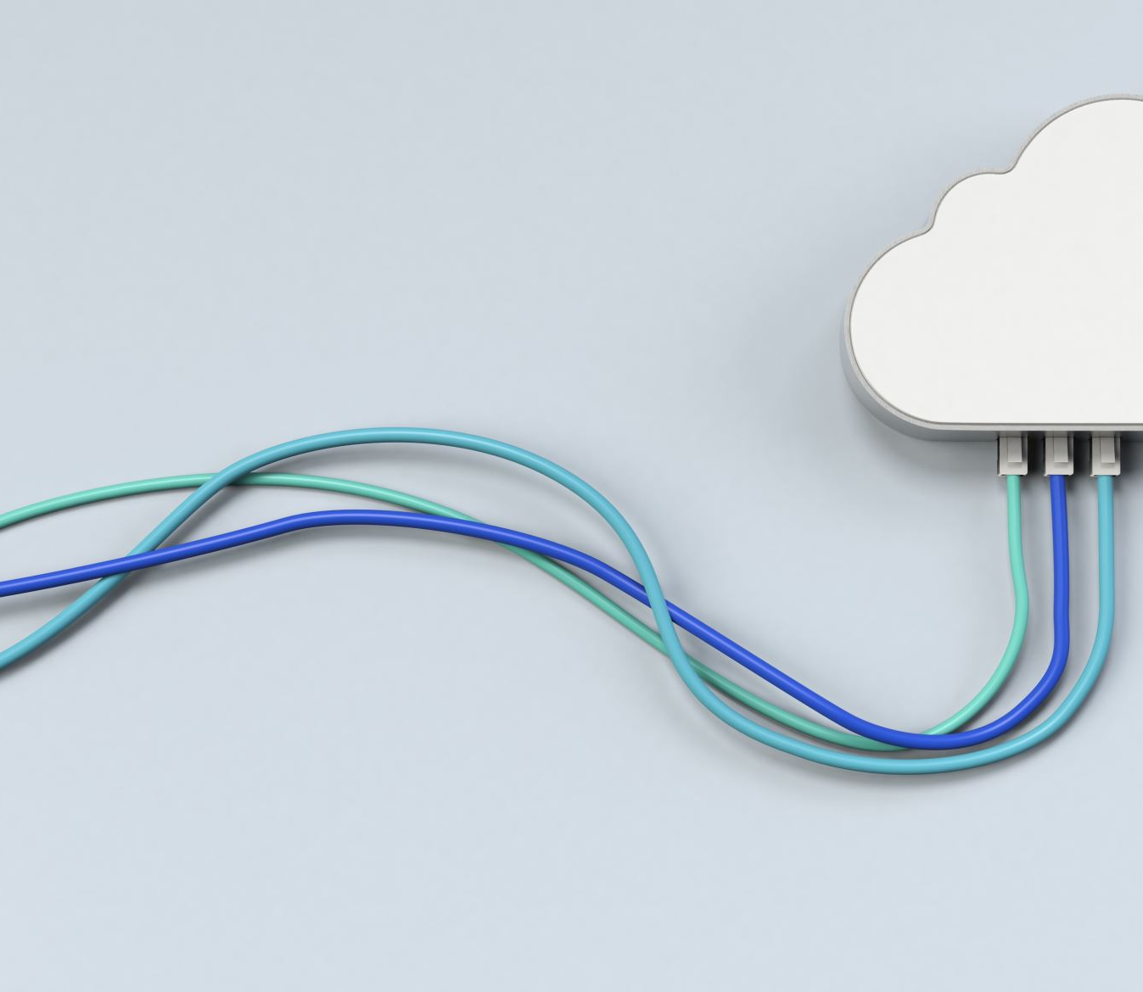
Virtualization
Technology that allows cloud as we know it
The goal of virtualization is to support portability, improve efficiency, increase reliability, and shield the user from infrastructure complexity.
For example, threads are virtual processors, abstractions that allow a processor sharing among different activities thus, increase utilization and effectiveness.
Processor virtualization, running multiple independent instances of one or more Operating Systems (OS), pioneered by IBM in early 1970s, was revived for computer clouds.
Running multiple VMs on the same server enables applications to better share the server resources and lead to higher processor utilization.

Slide 7
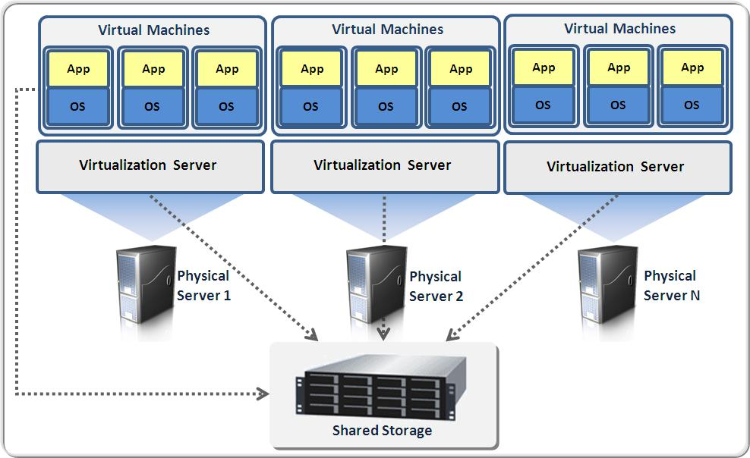
Virtualization
Processor Virtualization Impact
It allows better isolation of applications from one another than the traditional process-sharing model.
An application developer can chose to develop the application in a familiar environment and under the OS of choice
Provides more freedom for the system resource management because VMs can be easily migrated.
Increased complexity of system software and has undesirable side effects on application performance and security.
Processor sharing is now controlled by a new layer of software, the hypervisor, also called a Virtual Machine Monitor. VMs are heavyweight and non-portable.
.
This Photo by Unknown Author is licensed under CC BY-SA-NC

Slide 8
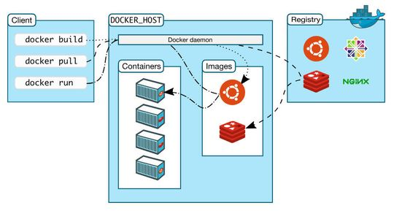
Containers
Containers are based on operating-system-level virtualization rather than hardware virtualization;
they isolate an application running inside a container from another application running in a different container and isolate them both from the physical system where they run.
Moreover, containers are portable, and the resources used by a container can be limited. They are more transparent than VMs, thus easier to monitor and manage.

Slide 9
Cloud Hardware

Slide 10
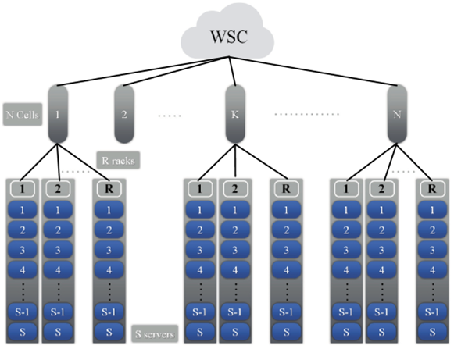
Warehouse-scale Computer (WSC)
WSC is a hierarchy of networks which connect the system components, servers, racks, and cells/arrays together.
WSCs support both interactive and batch workloads.
The communication latency and the bandwidth within a server, a rack, and a cell are different, thus, the execution time and the costs for running an application is affected by the volume of data, the placement of data, and by the proximity of instances.
Organization of a WSC with N cells, R racks, and S servers per rack
Notes:
Typically, a rack consists of 48 servers interconnected by a 48 port, 10 Gbps Ethernet (GE) switch.
In addition to the 48 ports, the GE switch has two to eight uplink ports connecting a rack to a cell.
Thus, the level of oversubscription, the ratio of internal to external ports, is between 48/8=6 and 48/2=24.
This has serious implications for the performance of an application; two processes running on servers in the same rack have a much larger bandwidth and lower latency than the same processes running on servers in different racks.
The next component is a cell, sometimes called an array, consisting of a number of racks.
The racks in a cell are connected by an array switch, a rather expensive communication hardware with a cost two orders of magnitude higher than that of a rack switch.
The cost is justified as the bandwidth of a switch with n ports is of order n².
To support a 10 times larger bandwidth for 10 times as many ports, the cost increases by a factor of 10². An array switch can support up to 30 racks.

Slide 11
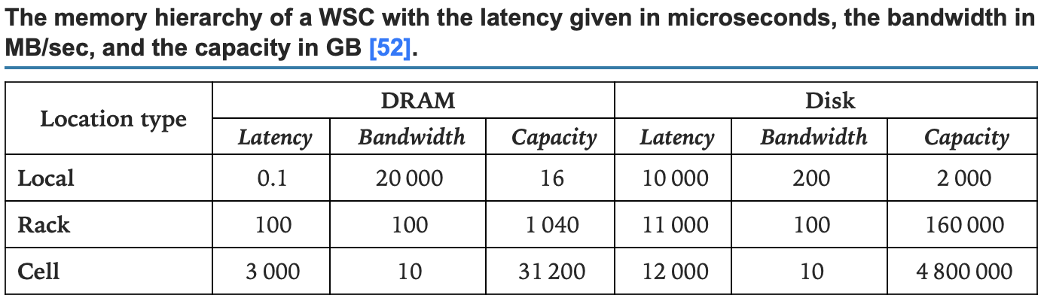
Warehouse-scale Computer (WSC)
Example
For example, the latency, the bandwidth, and the capacity of the memory hierarchy of a WSC with 80 servers/rack and 30 racks/cell
DRAM latency increases by more than three orders of magnitude, while the bandwidth decreases by a similar factor from server, to rack, and to cell.
The latency and the bandwidth of the disks follow the same trend, but the variation is less dramatic.
Notes:
To put this into perspective, the memory-to-memory transfer of 1 000 MB takes 50 msec within a server, 10 seconds within the rack, and 100 seconds within a cell, while disk transfers take 5, 10, and 100 seconds, respectively.

Slide 12
WSC Performance
Even slight WSC performance improvements translate into large cost savings for the CSPs and noticeably better service for cloud users.
WSCs workload is very diverse; there are no typical, or “killer,” applications that would drive the design decisions and, at the same time, guarantee optimal performance for such workloads. To profile realistic workloads and analyze carefully the data collected during production runs, WSC need low-overhead monitoring tools that minimize intrusion on the workloads

Slide 13
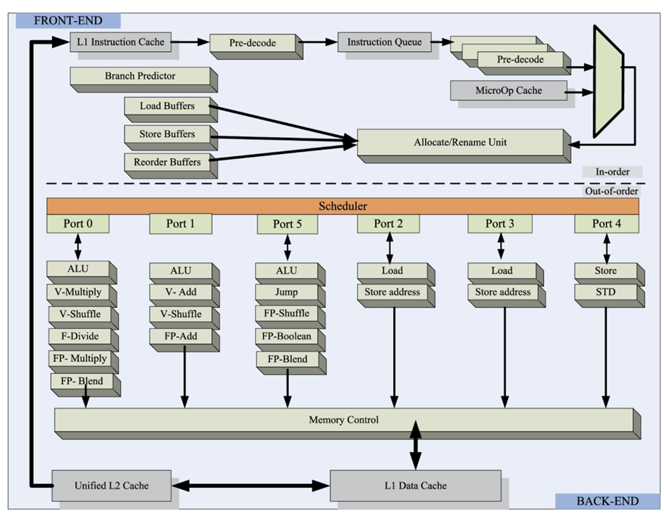
Schematic illustration of a modern processors core microarchitecture
Notes:
Shown are the front-end, the back-end, L1 instruction and data caches, the unified L2 cache, and the microoperation cache.
Branch prediction unit, load/store, and reorder buffers are components of the front-end.
The instruction scheduler manages the dynamic instruction execution.
The five ports of the instruction scheduler dispatch microinstructions to ALU and to load and store units.
Vector (V) and floating-point operations (FP) are dispatched to ALU units.
Fig. 4.2. The core front-end processes instructions in order,
while the instruction scheduler of the back-end is responsible for dynamic instruction scheduling and feeds instructions to multiple execution units including Arithmetic and Logic Units (ALU)s and Load/Store units.

Slide 14
Schematic illustration of a modern processors core microarchitecture
The microarchitecture-level analysis is based on a top-down methodology
This methodology identifies the micro-op (μop) queue as the separator between the front-end and the back-end components of a microprocessor core.
The μop pipeline slots are then classified as Retiring, Front-end bound, Bad speculation, or Back-end bound, with only the first one doing useful work.
Front-end bound includes overheads associated with fetching, instruction caches, decoding, and some other shorter-penalties and Back-end bound includes overheads due to the data-cache hierarchy and the lack of ILP; Bad speculation is self-explanatory.

Slide 15
Cluster Management System

Slide 16
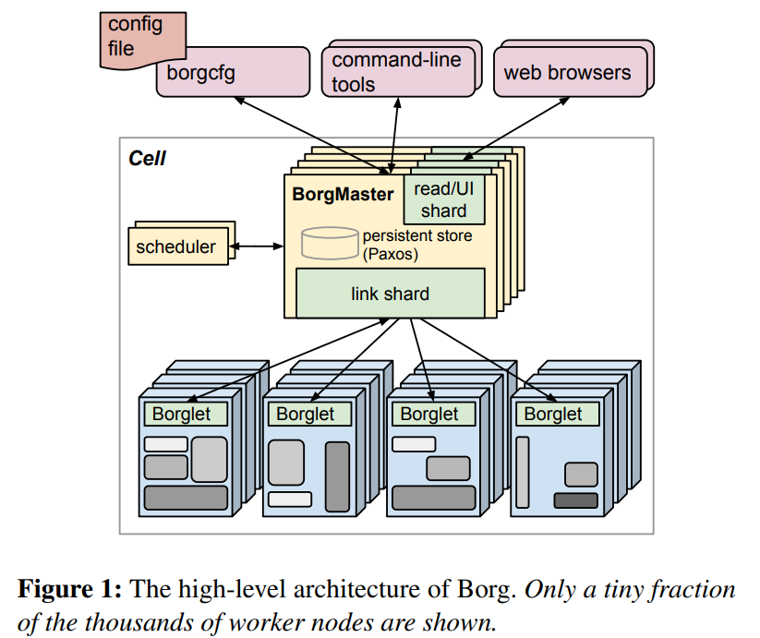
Evolution of a cluster management system
Study case from google
In 2011, Google published a one-month trace from a cluster managed with Borg.
In 2019, Google published again detailed job scheduling information from eight Borg cells
The comparison analysis of hardware used by the two traces, 2019 versus 2011:
  eight versus one cell,
  96400 servers versus 12600,
  7 versus 3 hardware platforms,
  21 versus 10 server configurations,
  and about the same number of servers per cell, 12000 versus 12000.
  https://research.google/pubs/large-scale-cluster-management-at-google-with-borg/

Slide 17
Evolution of a cluster management system
Study case from google
The 2019 scheduler is more agile and has to work harder, the number of jobs to be scheduled is seven times higher, and most of the workload has moved into the high-priority best-effort batch tier.
The heavy-tailed distribution of job sizes and the power law Pareto distribution with heavy tail of computing cycles and memory add to the scheduling challenges of 2019 Borg.
Significantly improved scheduling decisions led to an increase of both average CPU and memory utilization: 20–40% for CPU and 3–30% for memory.
The utilization variance is lower, and there were fewer servers with utilization larger than 80%. Median scheduling delays decreased, but the tail is longer for the last 28% of jobs.

Slide 18

Evolution of a cluster management system
Shared State Cluster Management
The scheduler workload increases with cluster size and with the granularity of the tasks to be scheduled.
The finer the task granularity, the more scheduler decisions have to be made; thus the likelihood of spatial and temporal resource fragmentation and lower resource utilization is higher.
The solution adopted in Omega's design is to allow multiple independent schedulers to access a shared cluster state protected with a lock-free optimistic concurrency control algorithm.

Slide 19
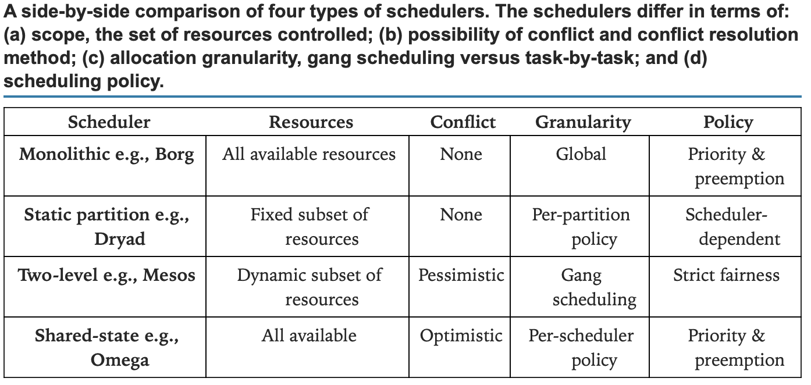
Evolution of a cluster management system
Schedulers comparison
Notes:
A monolithic scheduler using a centralized scheduling algorithm does not scale up.
Statically partition a cluster into sub-clusters allocated to different types of workloads. This policy is far from optimal due to fragmentation because the balance between different types of workload changes over time.
A two-level scheduler has its own limitations, such the collection of frameworks is not able to optimize bin packing and a centralized scheduler. The two-level scheduling model in this simulator emulates Mesos and achieves fairness by alternately offering all available cluster resources to different schedulers.
The simulation results show that Omega is scalable, and at realistic workloads, there is little interference among independent schedulers. The simulator was also used to investigate gang scheduling useful for MapReduce applications.

Slide 20
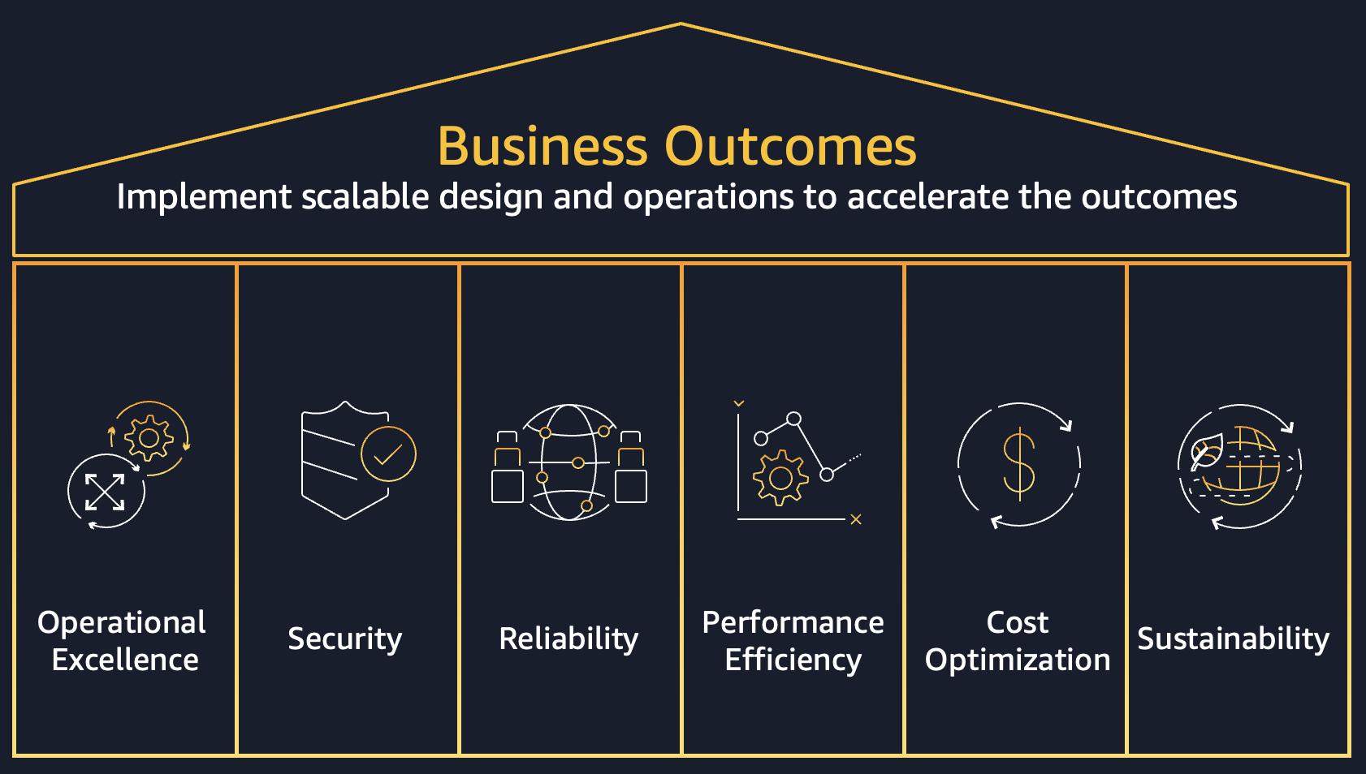
QoS-aware Cluster Management
You know what else is important?
Quality of Service (QoS) guarantees are important for the designers of cloud applications and for the users of computer clouds who wish to enforce a well-defined range of response time, execution time, or other significant performance metrics for their cloud workloads.
Two aspects of cluster management, resource allocation and resource assignment, play a key role for supporting QoS guarantees.
Resource allocation is the process of determining the amount of resources needed by a workload, while resource assignment means identifying the location of resources that satisfy an allocation.

Slide 21
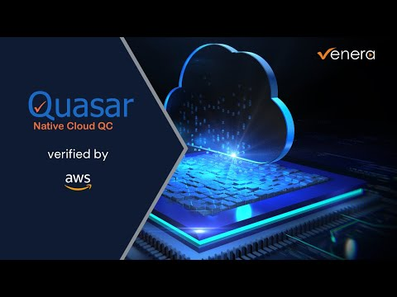
Quasar
You know what else is important?
A performance-centric approach for cluster management is implemented by two systems developed at Stanford University, Quasar and its predecessor Paragon
Quasar provides QoS guarantees and, at the same time, increases resource utilization. The process starts with an initial profiling of an application with short runs. The information from the initial profiling is expanded with information regarding four factors that can affect performance, scale up, scale out, heterogeneity, and interference. Then, the greedy scheduler uses the classification output to allocate resources that enable SLO compliance and maximize resource utilization.
https://mast.stanford.edu/pubs/quasar_resource_efficient_and_qos_aware_cluster_management/

Slide 22
Docker Containers

Slide 23
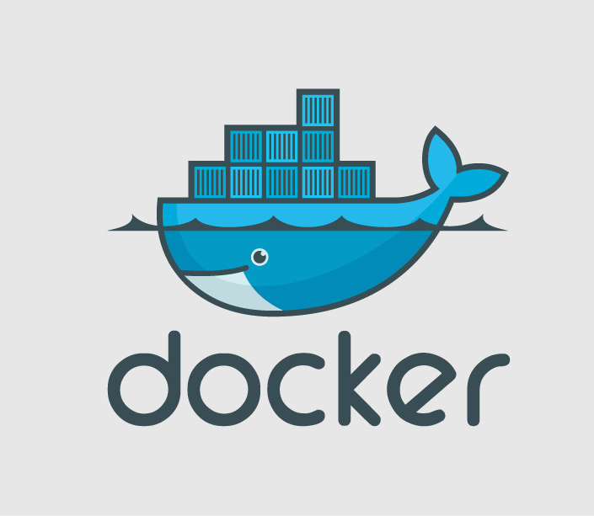
Docker container
Docker created containers along with a set of tools with standard APIs; it also made the same container portable across all environments.
Docker containers wrap a piece of software in a complete filesystem that contains everything needed to run: code, runtime, system tools, system libraries—anything that can be installed on a server. This guarantees that the software will always run the same, regardless of its environment.
This Photo by Unknown Author is licensed under CC BY-SA

Slide 24
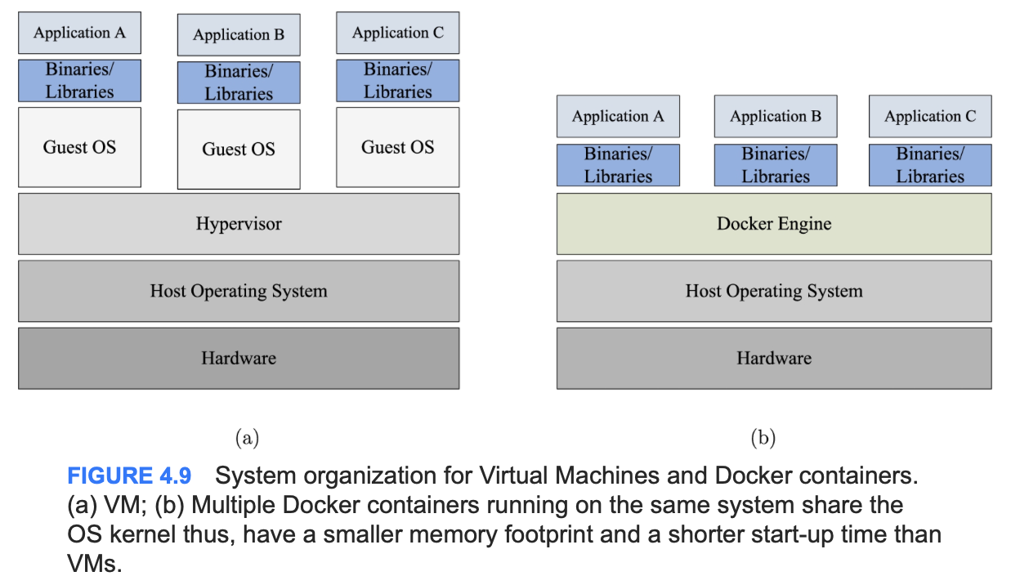
System organization for Virtual Machines and Docker containers

Slide 25
Containers
Benefits
One of the main benefit of container is that Applications are decoupled from the infrastructure; buy it also allows:
Ease creation and deployment of applications.
Support portability; containers run independently of the environment.
Benefit from an application-centric management.
Have an optimal philosophy for application deployment; applications are broken into smaller, independent pieces and can be managed dynamically.
Support higher resource utilization.

Slide 26
Docker container
Advantages
Containers are light weight, cost-effective in a public cloud environment, provide better performance, and require fewer hardware resources for a private cloud.
Containers isolate an application from the underlying infrastructure
Multiple containers running on the same machine share the OS kernel, have a smaller memory footprint, and a shorter start-up time than VMs.
Docker containers is increased productivity. Containerization allows developers to choose the most suitable programming languages and software systems and eliminates the need to make copies of production code and install the same configuration in different environments.
It also supports efficient up and down scaling of an application
This Photo by Unknown Author is licensed under CC BY-SA

Slide 27
kubernetes

Slide 28
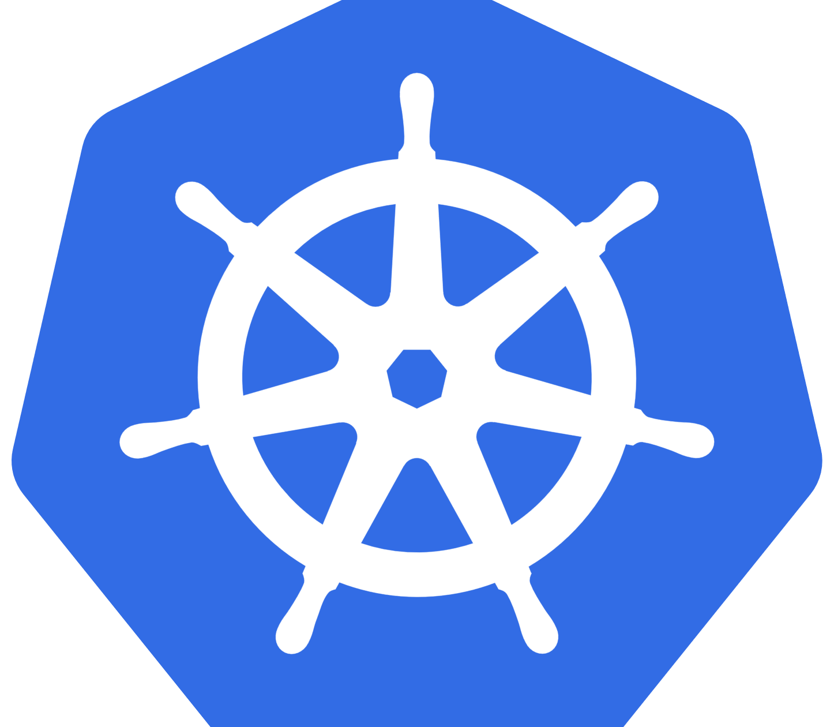
Kubernetes
Kubernetes is a cluster manager for containers.
The origin of the word Kubernetes is in ancient Greek language: “kubernan” means to steer and “kubernetes” is helmsman.
Kubernetes is an open source software system developed and used at Google for managing containerized applications in a clustered environment.
This Photo by Unknown Author is licensed under CC BY-SA

Slide 29
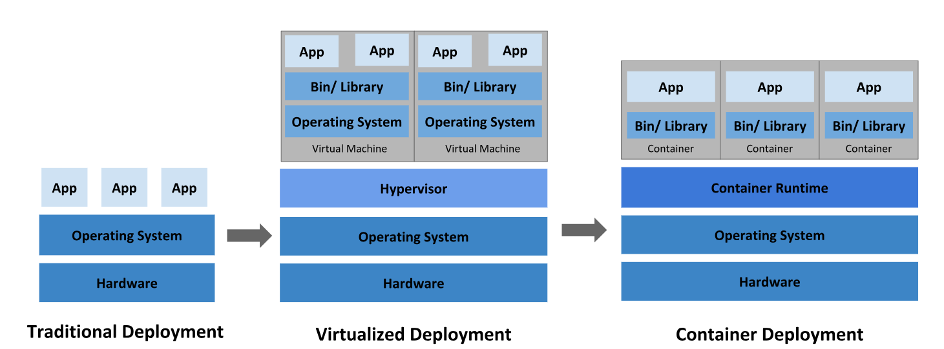
Kubernetes
Kubernetes is an open-ended system and its design allowed a number of other systems to be build atop Kubernetes.
Kubernets does not provide built-in services including message buses, data-processing frameworks, databases, or cluster storage systems and does not require a comprehensive application configuration language.
Kubernets provides deployment, scaling, load balancing, logging, and monitoring.
Kubernetes is not monolithic, and default solutions are optional and pluggable.

Slide 30
Kubernetes organization
A master server manages a Kubernetes cluster and provides services to manage the workload and to support communication for a large number of relatively unsophisticated minions servers that do the actual work.
Etcd is a lightweight, distributed key-value store to share configuration data with the cluster nodes.
Minions use a docker service to run encapsulated application containers. A kubernet service allows minions to communicate with the master server and with the etcd store to get configuration details and update the state. A proxy service of the minions interacts with the containers and provides a primitive load balance.
Notes:
In Kubernetes, pods are groups of containers scheduled onto the same host and serve as units of scheduling, deployment, horizontal scaling, and replication. Pods share fate and share resources such as storage volumes.
Pods manage co-located support software including: content management systems, controllers, managers, configurators, updaters, logging and monitoring adapters, and event publishers.
Pods also manage file and data loaders, local cache managers, log and checkpoint backup, compression, rotation, snapshotting, data change watchers, log trailers, proxies, bridges, and adapters.

Slide 31
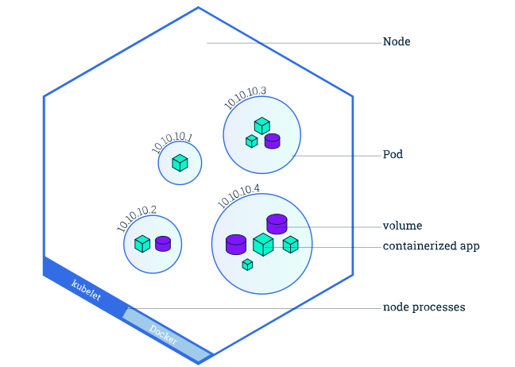
Kubernetes organization
In Kubernetes, pods are groups of containers scheduled onto the same host and serve as units of scheduling, deployment, horizontal scaling, and replication.
Pods share fate and share resources such as storage volumes.
Pods manage co-located support software including: content management systems, controllers, managers, configurators, updaters, logging and monitoring adapters, and event publishers.
Pods also manage file and data loaders, local cache managers, log and checkpoint backup, compression, rotation, snapshotting, data change watchers, log trailers, proxies, bridges, and adapters.
Notes:
Arguably, pods are preferable to running multiple applications in a single Docker container for several reasons:
(i) efficiency—containers can be lightweight as the infrastructure takes on more responsibility;
(ii) transparency and user convenience—containers within the pod are visible to the infrastructure and allow it to provide process management, resource monitoring, and other services;
(iii) users do not need to run their own process managers, or deal with signal and exit-code propagation; and
(iv) decoupling software dependencies—individual containers may be versioned, rebuilt, and redeployed independently.

Slide 32
Exercise
Present a case where using a VM is superior compared to container vice versa

Slide 33
References
Marinescu, Dan C. (2022). Cloud Computing Theory and Practice: 3rd Edition. Morgan Kaufmann Publishers. ISBN: 978-0-323-85277-7
https://www.youtube.com/watch?v=AeiXe7GRGCE
https://kubernetes.io/docs/home/

Slide 34
Thankyou

